Slide 1
Impact Mapping
Chatbot solution for the FHNW module Business Intelligence

Slide 2
Table of Content
Introduction
Impact Map
Goal
People

Slide 3

Introduction

Slide 4

Introduction
This document became created in order to visualize the impact map which was elaborate regarding a potential chatbot solution
The impact becomes measured by the two key stakeholder which are the student and the teacher

Slide 5

Impact Map

Slide 6
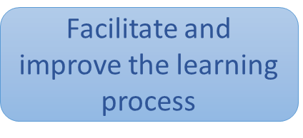

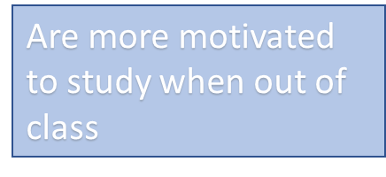
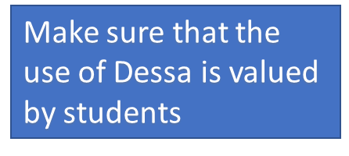
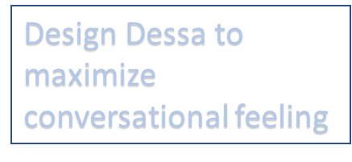
Legend
Business goals / why?
People/ who?
Change of behavior/ How? How can people’s behavior change? (Things we cannot control)
Deliverables/ What?
How can the project team support the required impacts? (In our control)
Derived requirements or tasks. (Sub What)

Slide 7
Design Dessa to maximize conversational feeling
Develop Dessa functionalities according to teacher's expectations
Develop dessa so that it can be customized easily according to the teacher’s preferences
Uses Dessa to design their module
Equip Dessa with monitoring, statistical analysis and reporting function to teacher
Implement in report to teacher “most used keywords”
Able to know what concepts require further explanation
Teacher
Ability to limit “finding out lack of understanding” during exam
Equip Dessa with a “relevant for exam” function which redirects to the multiple topics. Ask questions about all relevant concepts
Facilitate and improve the learning process
Are more motivated to study when out of class
Design Dessa to maximize conversational feeling
Open questions function
Student
Make sure that the use of Dessa is valued by students
Have usually acquired a sufficient understanding of the basic concepts required for class
Develop an overview function with personalized indication “state of understanding”
Gather required knowledge and store it in knowledge bases
Can verify their state of understanding about a concept
Connect knowledge bases to Dessa with possibility to extract
At request, can get indications on where to find the wished information
Develop a “where can I find information about …” function

Slide 8

Goal

Slide 9

The goal: facilitate and improve the learning process
SPECIFIC: improve learning in and out of class,
in class, by using class for diving deeper into the applications of the concepts,
out of class, by allowing students to get a good understanding of the basic concepts of the module and supporting them to study effectively. Ease of use and practicality can enhance the students' motivation.
MEASURABLE: the number of concepts not understood for the exam is reduced to a minimum (5%?)
ACTION-ORIENTED: this goal is allowed by the development and use of Dessa
REALISTIC: the functionalities of Dessa are technically proved and tried.
TIMED: first introduction of the tool by September 2021

Slide 10

People

Slide 11

People: The teacher
The teacher can influence the achievement of the goal by making use of Dessa for his classes. As the customization of the chatbot is an additional effort for him, it is necessary that he is convinced about the added value that he could gain from it.

Slide 12

People: The student
Students have also an essential influence on the achievement of the goal. Whether or not the use of Dessa among students increases is a critical factor of the successful implementation of Dessa.

